Slide 1
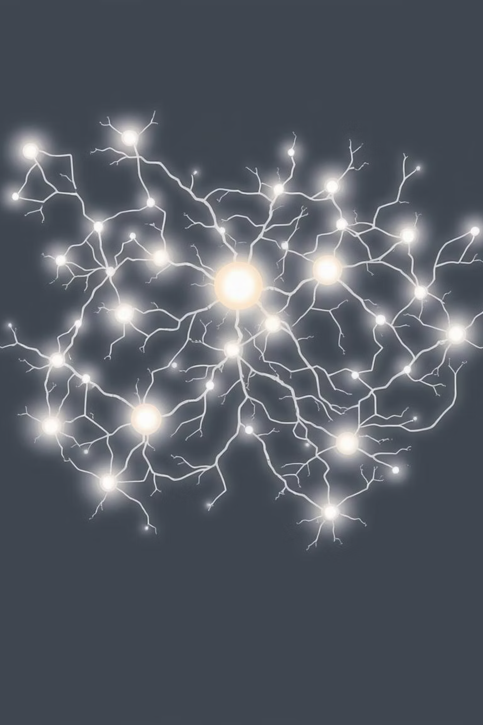

GPT Supported XML Transformation Project
Explore the GPT-powered AI component at the heart of my AWS-based XML transformation project. This presentation will convey the technical details and user experience of the project.

Slide 2




PROJECT OVERVIEW
Intelligent XML Transformation
This project is an automated system that uses AWS services (S3, Lambda, SQS, CloudFormation) to convert items.xml files to products.xml format. While the transformation process was carried out with XSLT, an innovative GPT integration was introduced to improve user interaction.
AWS Infrastructure
XSLT Transformation
GPT Integration
Secure and scalable infrastructure with S3, Lambda, SQS, and CloudFormation.
Accurate and efficient data formatting between XML files.
Ability to modify XML content with natural language.

Slide 3
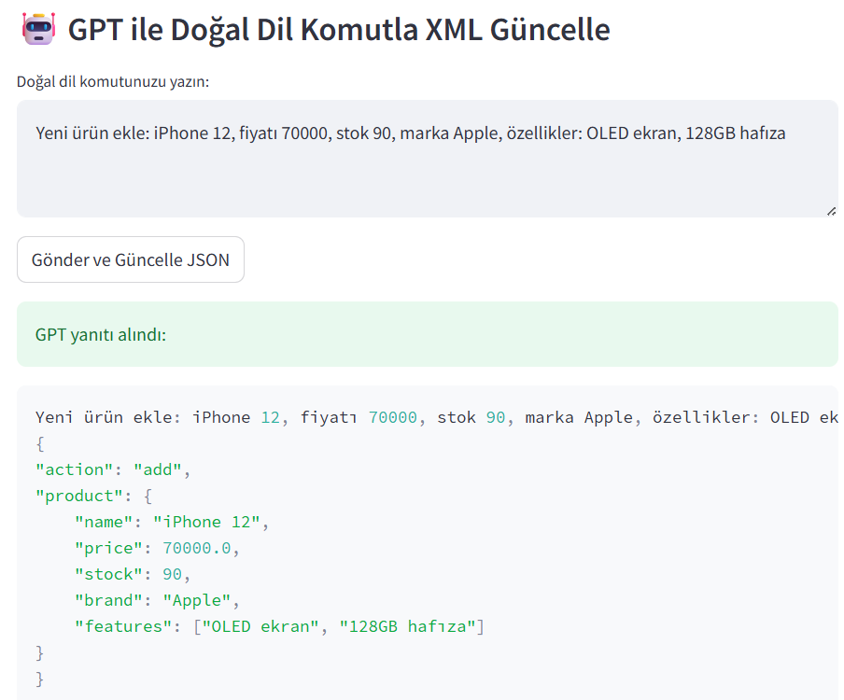
GPT INTEGRATION
Natural Language Interface
Our system offers a GPT-powered natural language interface so that users can make content updates without the need for technical XML knowledge. This speeds up business processes and reduces errors.
Traditional Approach
GPT-Powered Approach
Requirement of complex XSLT knowledge
Simple English commands
Manual XML edits
Automatic XML changes
High probability of making mistakes
User-friendly interface

Slide 4



USER INTERACTION
XML Management with Verbal Commands
Users can interact through the Streamlit app or directly with the system using natural language commands. For example, they can make complex XML updates with simple commands such as "Change the price of all products in category A to 10".
User Command
GPT Processing
XML Update
Enters demand in natural language.
Understands the command and prepares the XML transformation.
The changes are applied automatically.

Slide 5

CONVERSION MECHANISMI
Processing of Responses
Responses from GPT are carefully processed by our system. The model creates the XSLT transformation, which is automatically applied by AWS Lambda functions to update the XML files.
Receiving the Response
From GPT comes the XSLT conversion command.
Verification
The validity of the generated XSLT code is checked.
Application
Applied to XML files via Lambda.

Slide 6
SAMPLE INTERACTION
Before & After
The example below shows how GPT-based interface converts XML files.
Before (items.xml)
After (products.xml)
<items>
<item>
<number>001</number>
<name>Akıllı Telefon</name>
<brand>Samsung</brand>
<price>40000</price>
<price2>42000</price2>
<features>
<feature>128GB Hafıza</feature>
<feature>6.5 inç ekran</feature>
</features>
<stock>?</stock>
</item>
<item>
<product id="4">
<name>iPhone 15</name>
<brand>Apple</brand>
<price>65000</price>
<features>
<feature>OLED ekran</feature>
<feature>128GB hafıza</feature>
</features>
<stock>15</stock>
</product>
</products>
Command: "Yeni ürün ekle: iPhone 15, fiyatı 65000, stok 15, marka Apple, özellikler: OLED ekran, 128GB hafıza."

Slide 7
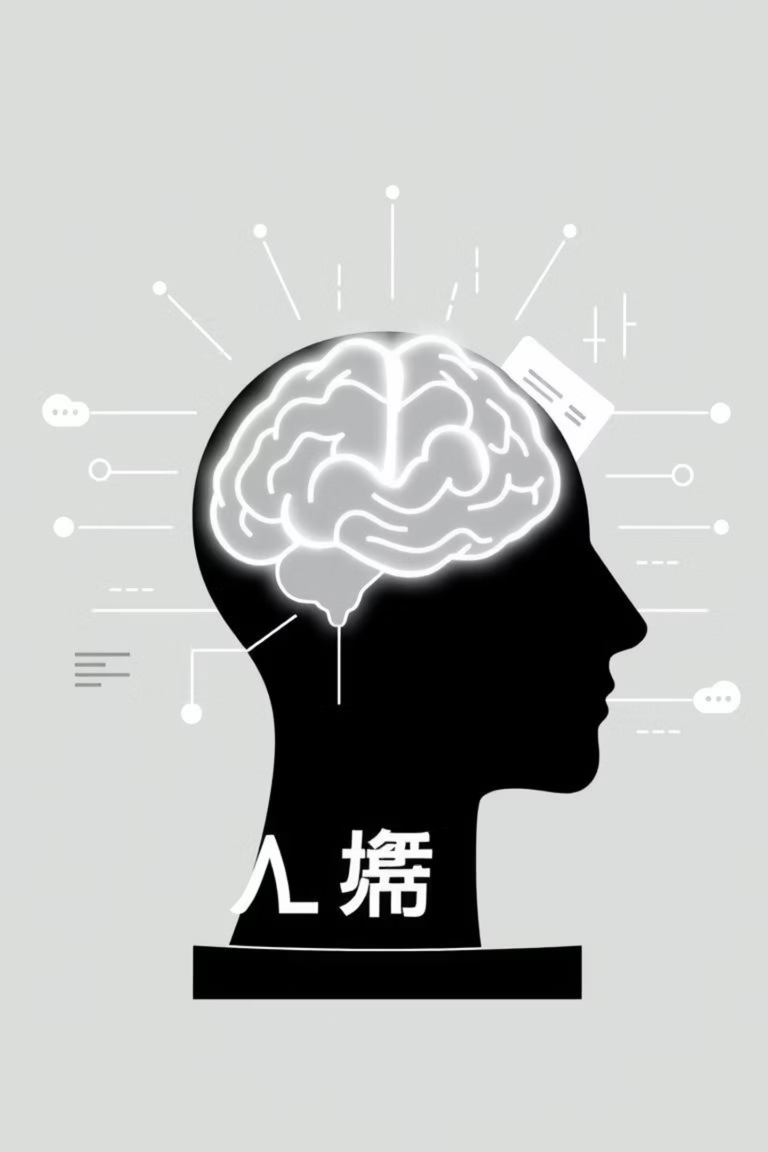
Artificial Intelligence Supported Documentation Creation Project
Discover our innovative solution that automatically converts technical documents into wiki-style documentation.

Slide 8




Documentation Workflow
Our project follows the steps below to convert technical documents into wiki-style documentation:
1. Document Upload
2. Text Extraction
Kullanıcı, PDF veya görsel dosyasını sisteme yükler.
OCR teknolojisi ile görselden metinler ayrıştırılır.
3. Submission to LLM
4. Wiki Creation
The extracted texts are sent to the Mistral model.
The LLM generates wiki-style documentation from texts.

Slide 9
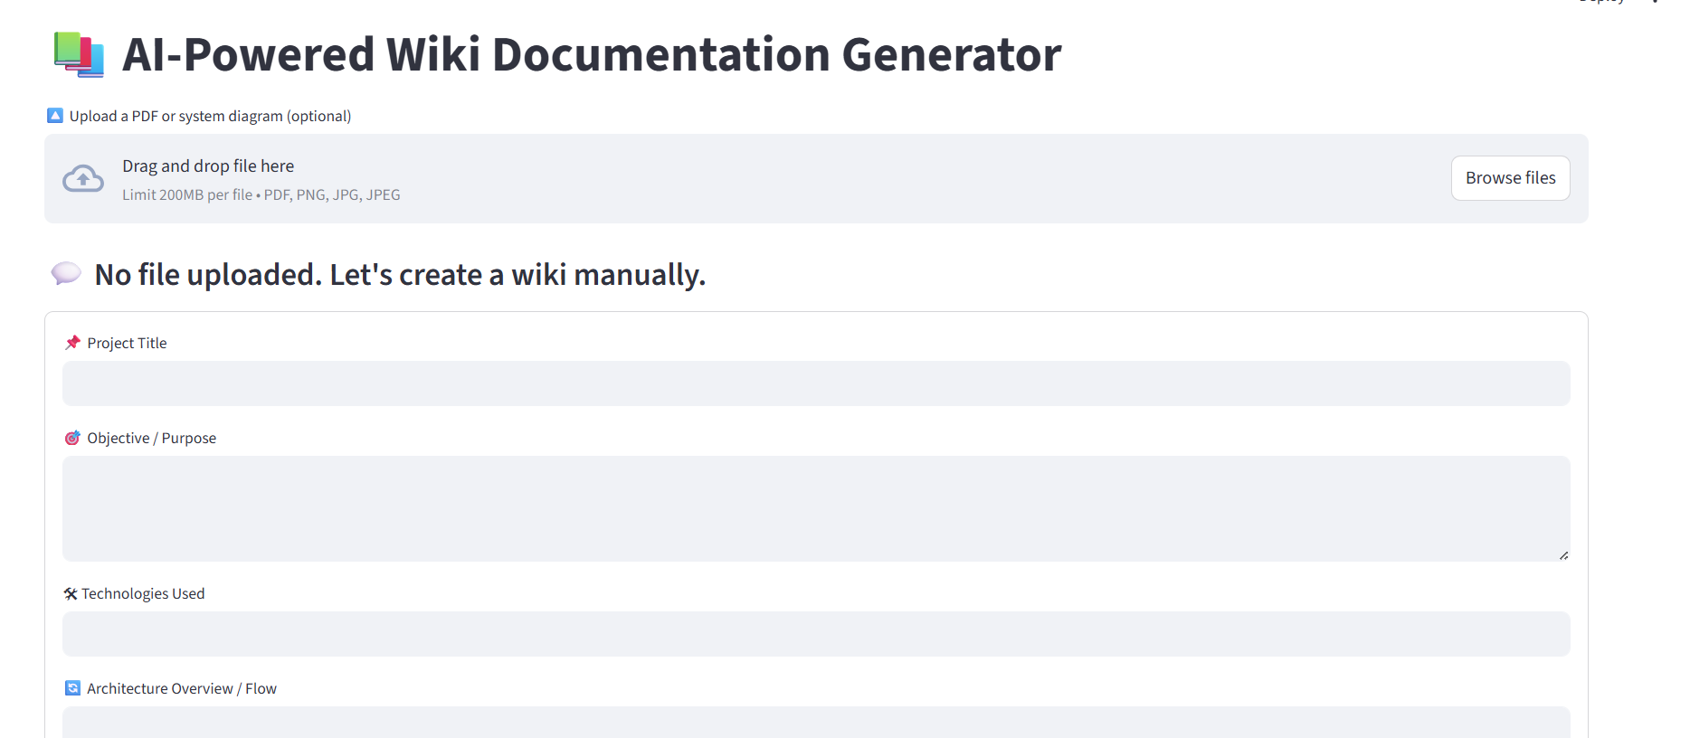
User-Friendly Interface
The user interface developed using Streamlit allows even non-technical stakeholders to use the system comfortably.
Simple Upload: Easily upload files using drag-and-drop.
Instant Feedback: Get instant information about transaction status.
Readable Output: The generated wiki documentation is clear and organized.

Slide 10
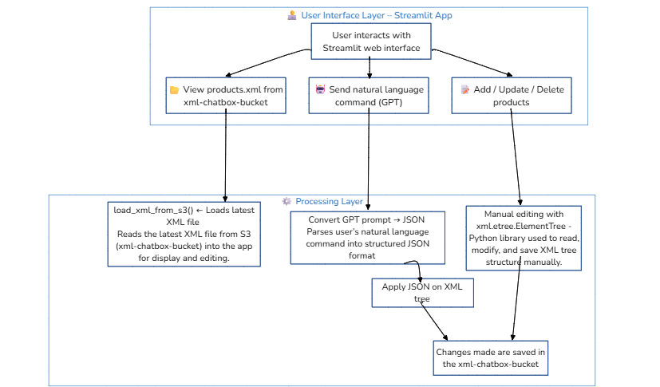
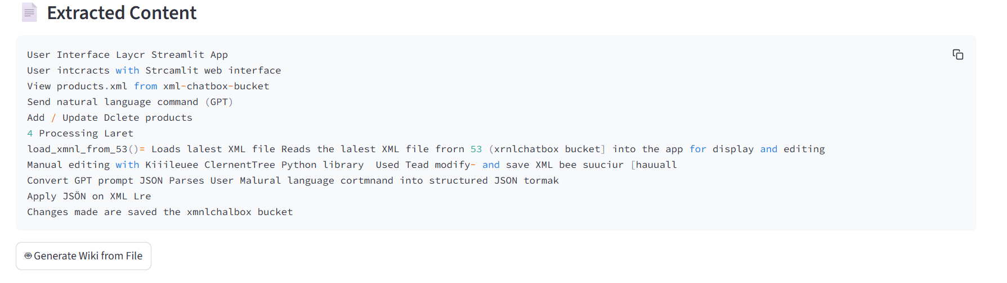

Slide 11
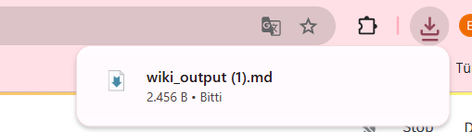
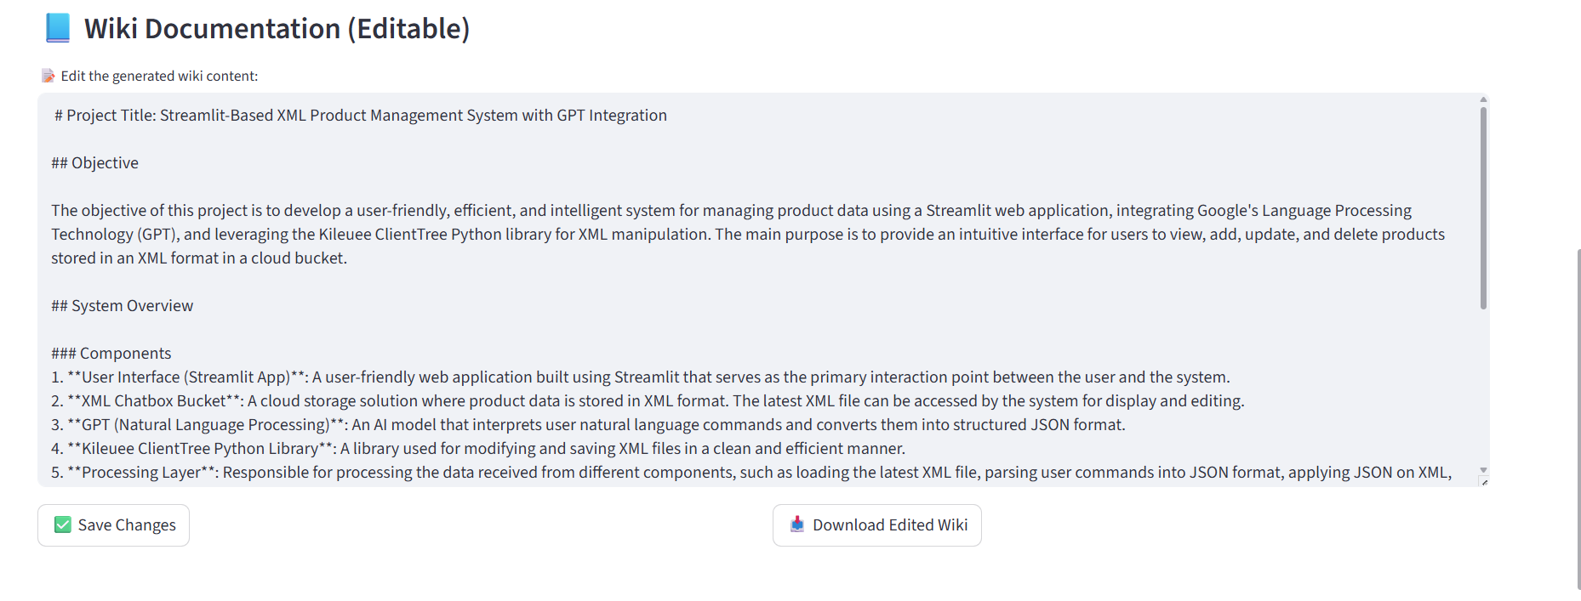

Slide 12
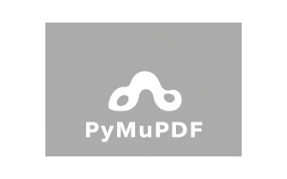

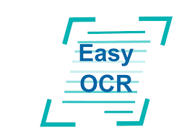

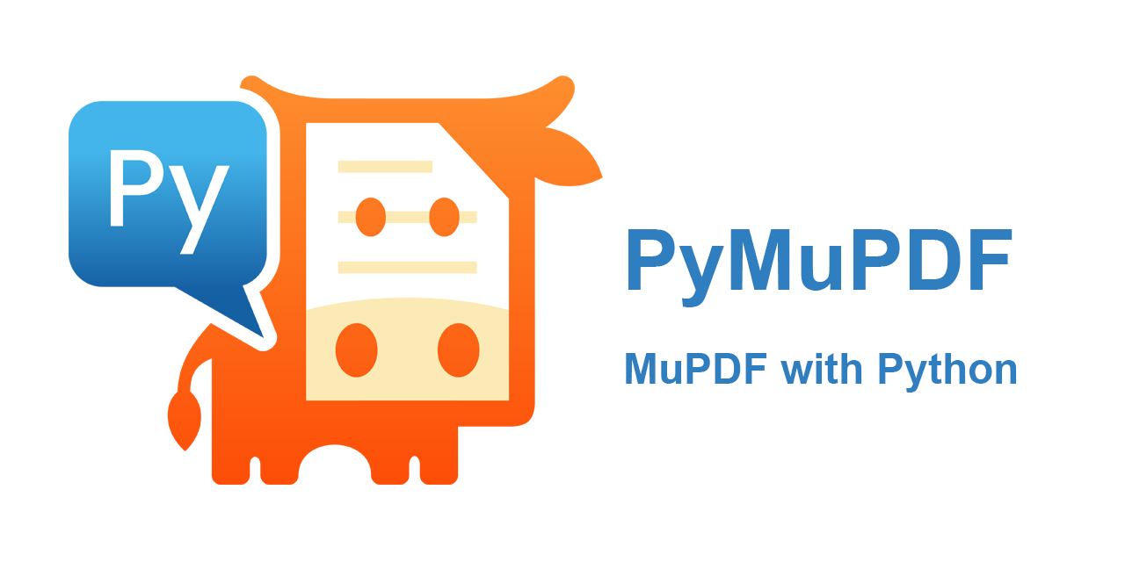

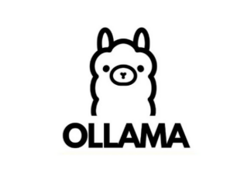
The Power of the Technologies Used
A language model based on text inputs. It is used to create wiki pages. It is fast and lightweight.
Recognizing text from image (PNG/JPG) content It is an open-source OCR library used for
It provides interactive web interface for the user to upload files, make edits, and download the output.
It provides direct text extraction from PDF files. If there is no text, it is backed up by EasyOCR.
To easily run native LLM (such as Mistral) models It is an interface/infrastructure used.
Our project combines industry-leading open-source technologies to provide a powerful and flexible solution. This integration ensures high performance and cost-effectiveness.

